Slide 1
CAR PARKING SEMULATION
BG02
1- Hayan Al-Machnouk
2- Tamam Alahdal
3- Zyad Zamil
Main Algorithm Design
EE-463 Term Project

Slide 2
TABLE OF CONTENTS
01
02
03
04
06
07
INTRODUCTION
Flowchart
MAIN
CAR
GENERATION
05
08
MONITOR
IN-VALET
OUT-VALET
Exiting

Slide 3
01
INTRODUCTION

Slide 4
INTRODUCTION
Threads: the program will use a set of threads to perform certain functions.
Mutex: a Mutex will be used to protect the shared resources in the program
Semaphores: Semaphores will be used to avoid the busy-waiting
Car park array: a park array will be used to represent the car park space.
Car Queue: we implemented Queue data structure to hold cars.

Slide 5
02
Flowchart

Slide 6
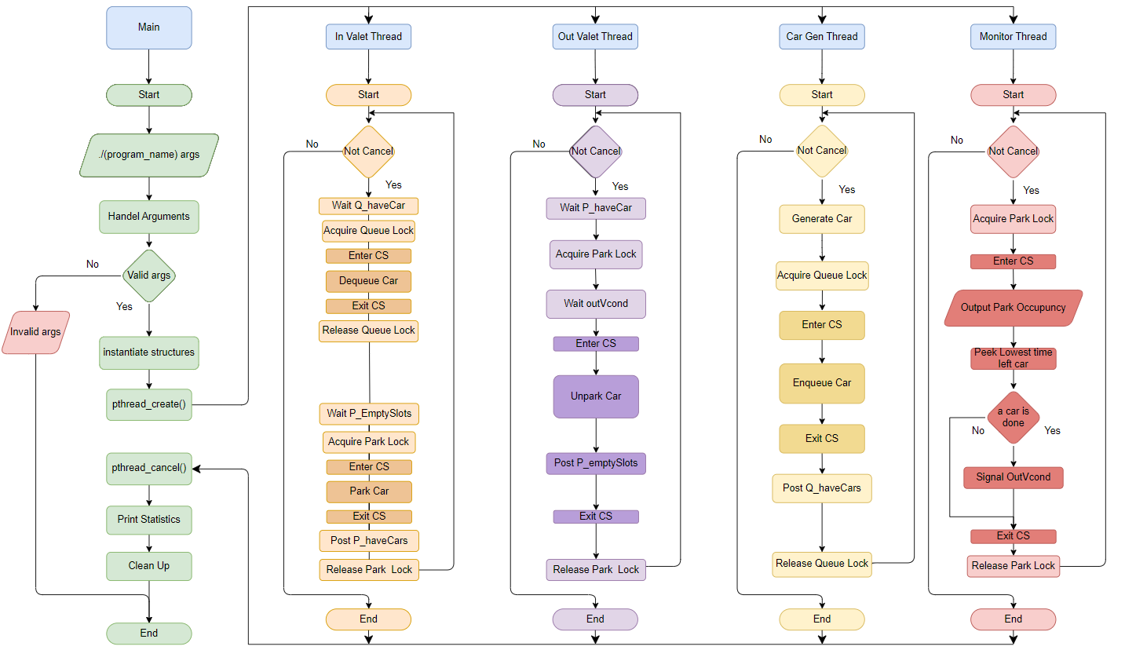

Slide 7
03
MAIN THREAD

Slide 8
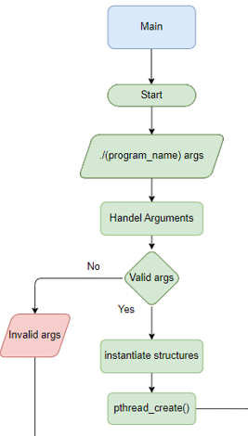



ARGUMENTS
INITIALIZE STRUCTURES
CREATE THREADS

Slide 9
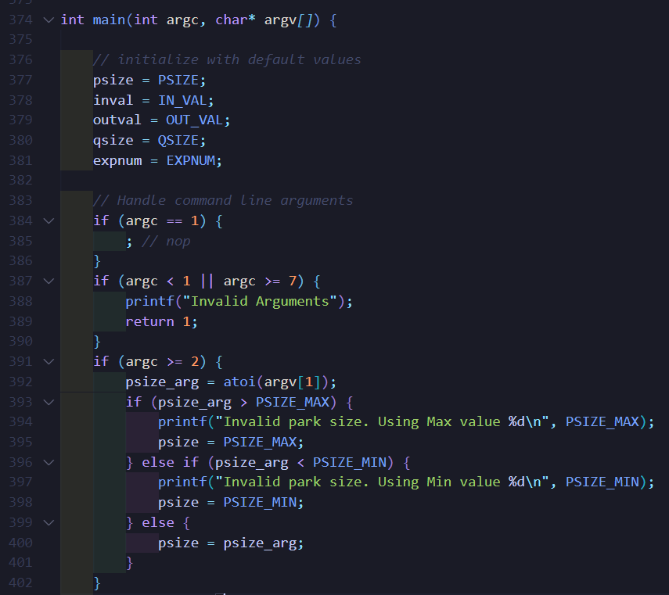

Slide 10
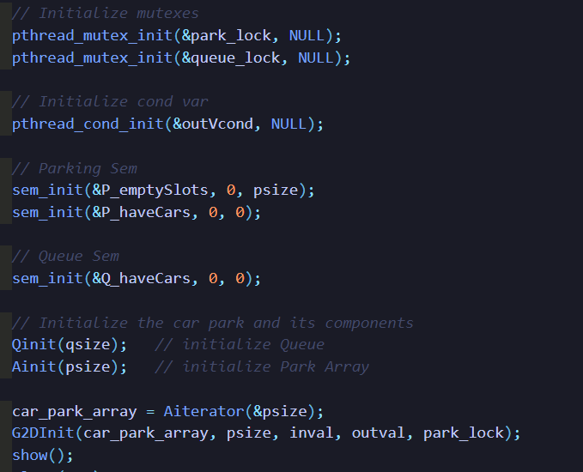

Slide 11
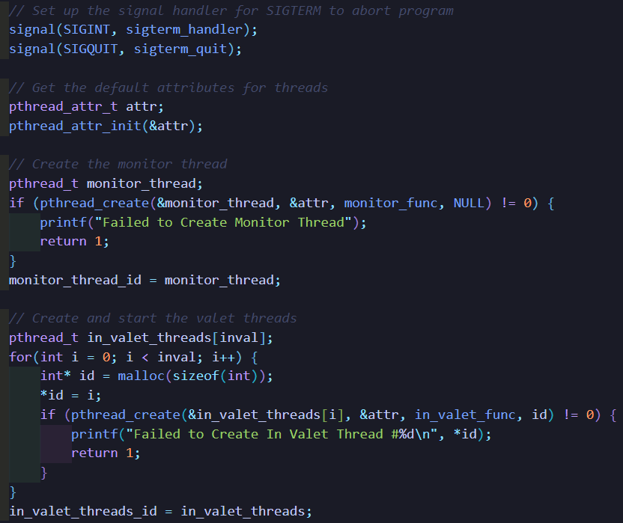

Slide 12
04
CAR GENERATION THREAD

Slide 13
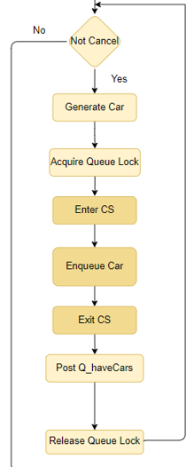



ENDLESS LOOP
GENERATING CARS
ENTER CS QUEUE
ADDING CARS
EXIT CS QUEUE

Slide 14
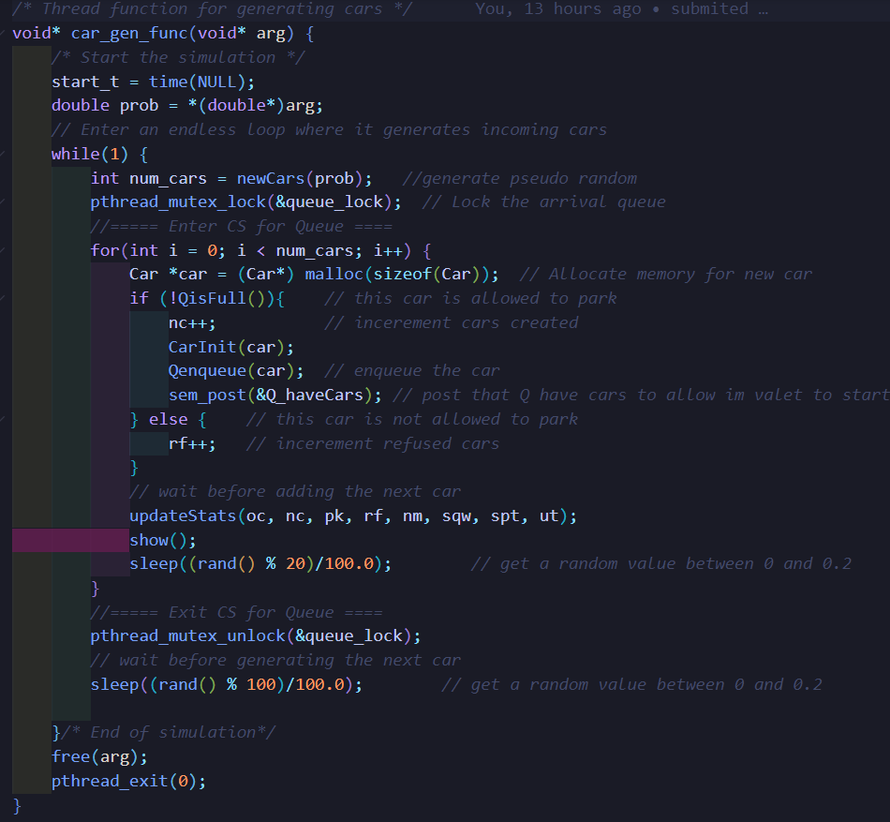

Slide 15
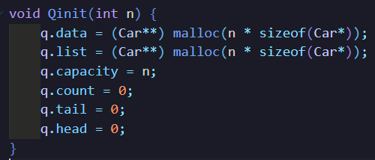
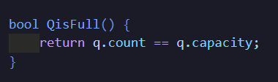
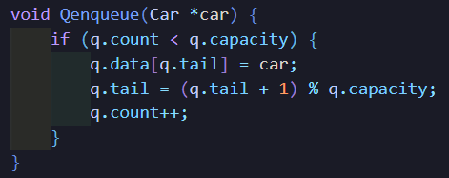

Slide 16
05
MONITOR THREAD

Slide 17


MONITOR THREAD
ENTER CS PARK
UPDATING STATE
EXIT CS PARK
CALCULATING

Slide 18


Slide 19
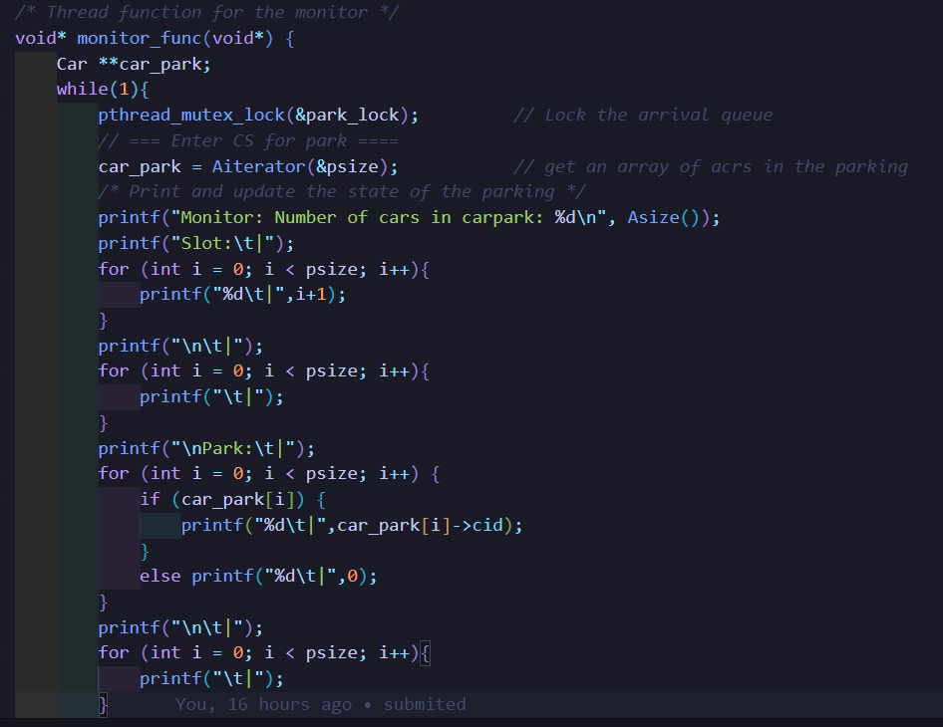

Slide 20
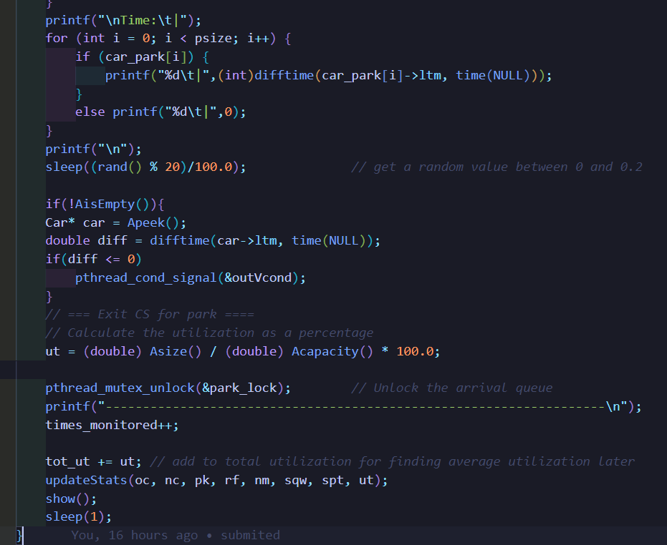

Slide 21
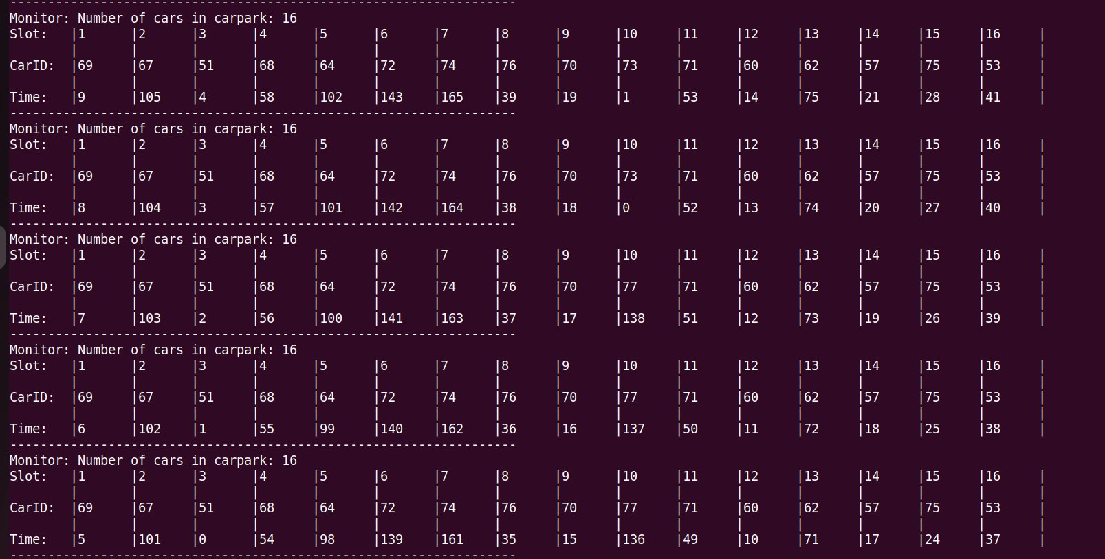

Slide 22
06
IN-VALET THREAD

Slide 23

IN-VALET THREAD
ENTRY SECTION
CRITICAL SECTION
EXIT SECTION

Slide 25
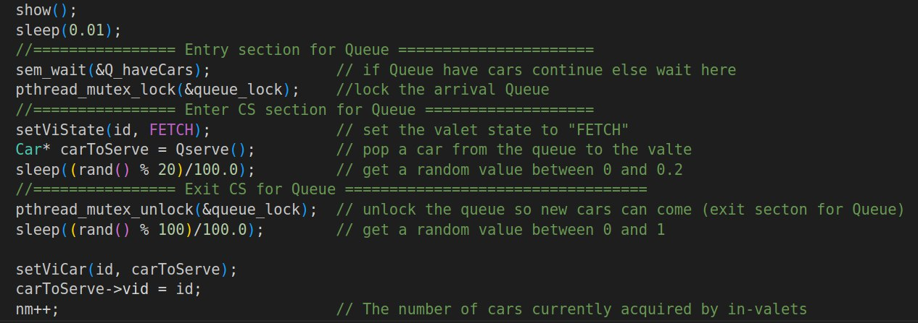

Slide 26
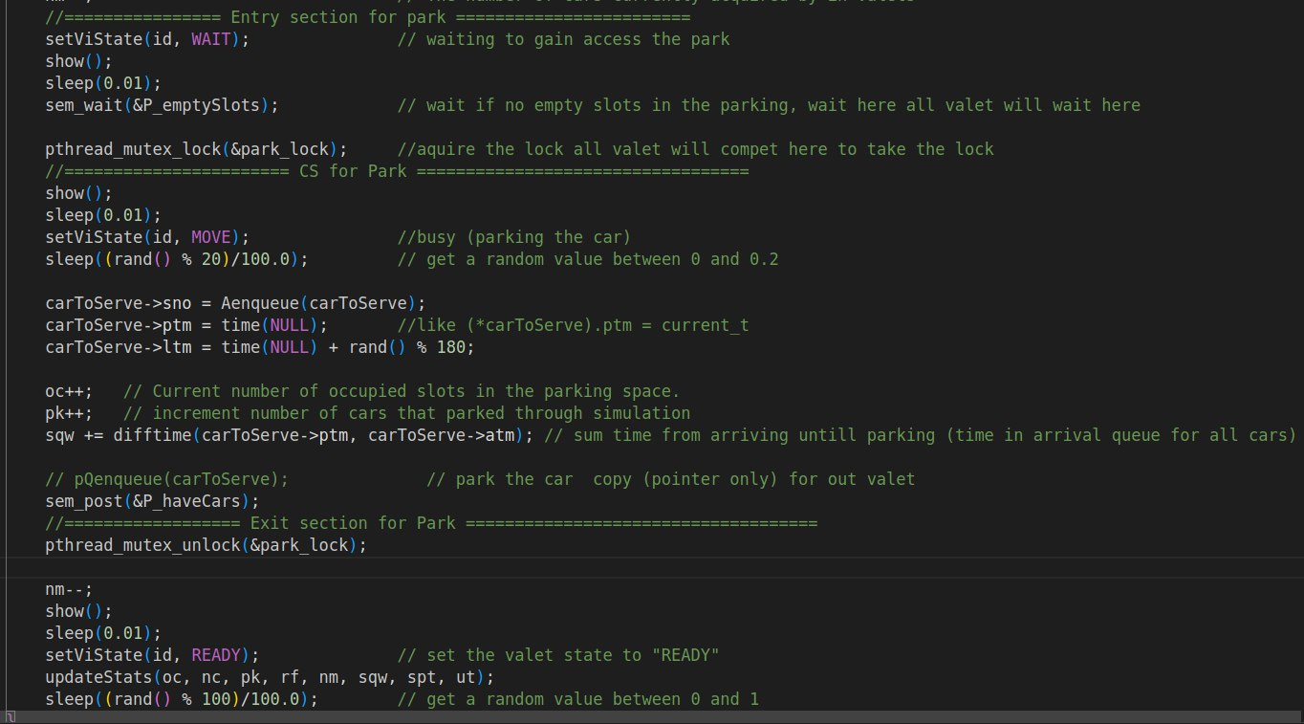

Slide 27
07
OUT-VALET THREAD

Slide 28
OUT-VALET THREAD
ENTRY SECTION
CRITICAL SECTION
EXIT SECTION

Slide 30
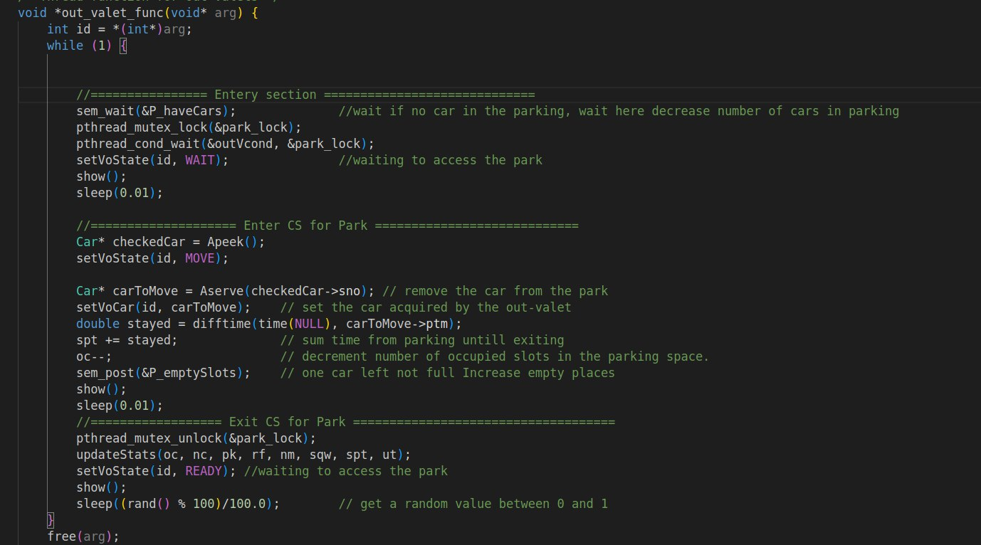

Slide 31
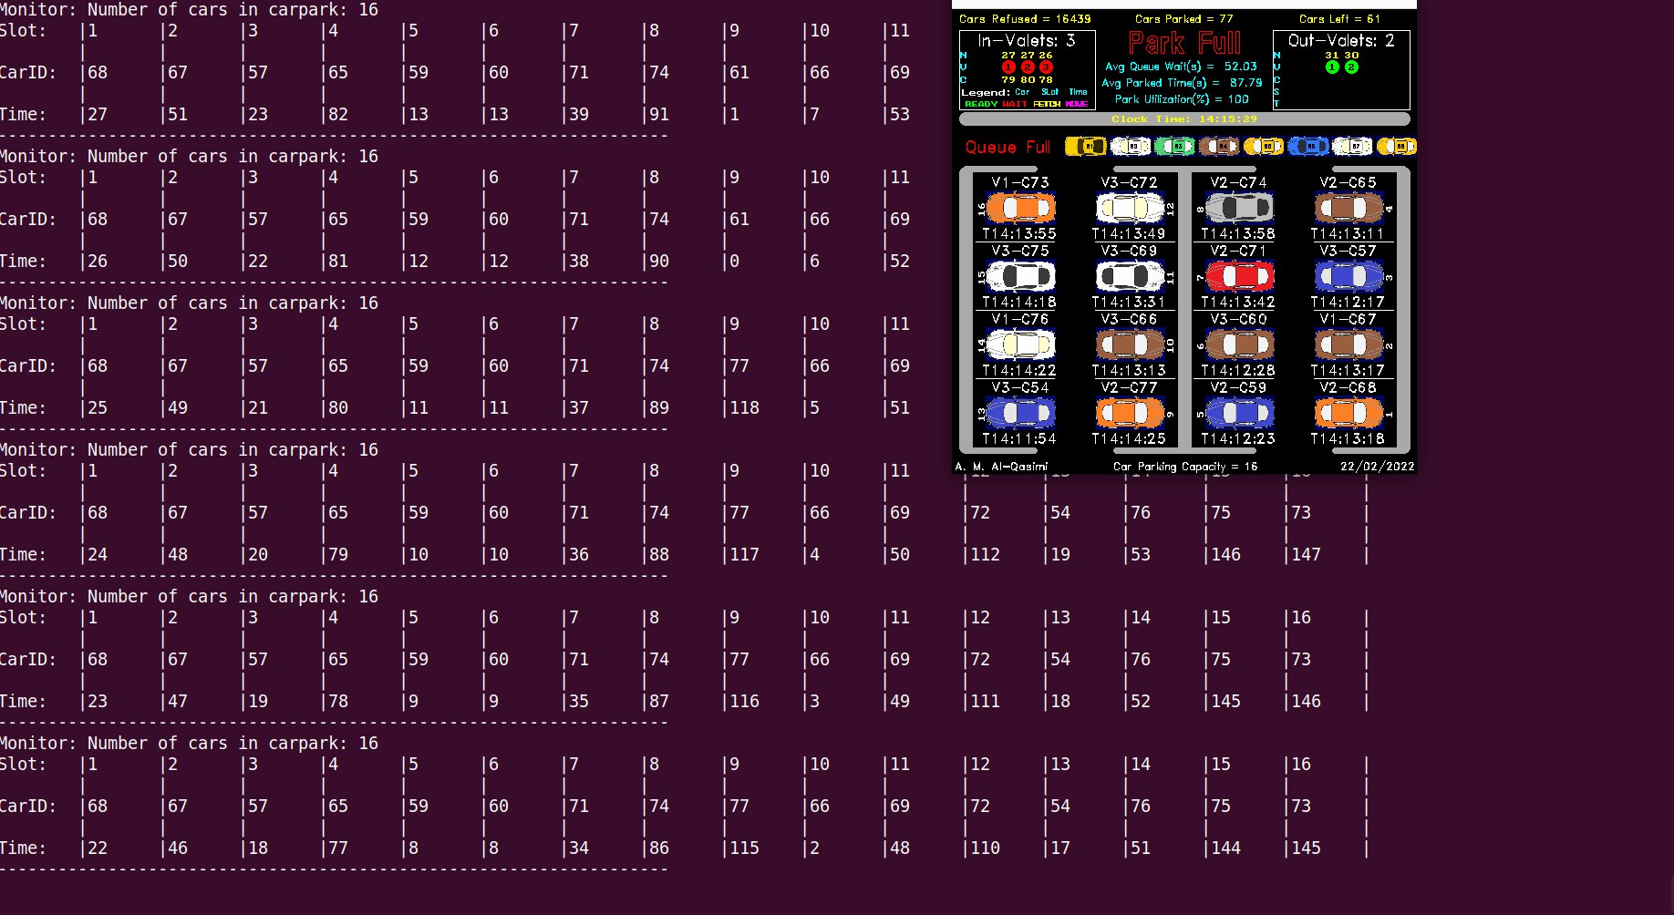

Slide 32
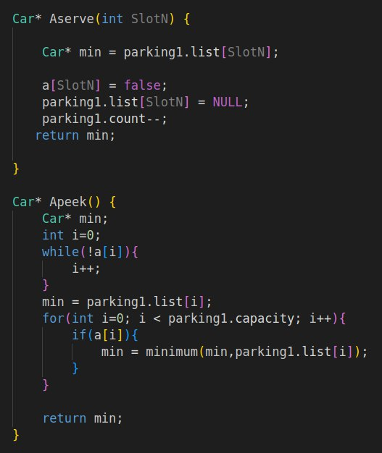
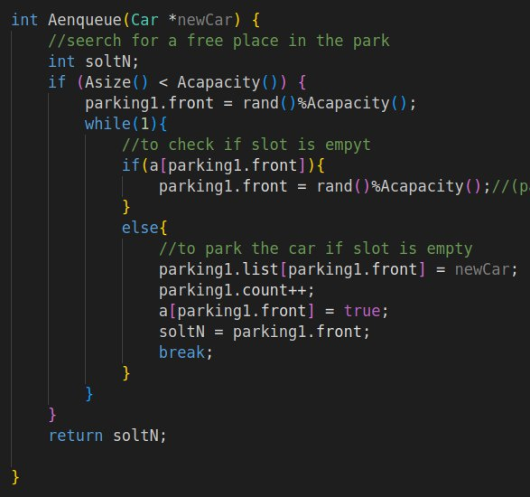

Slide 33
08
Exiting

Slide 34
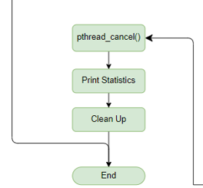



STOP SIMULATION
PRINT STATISTICS
CLEAN UP

Slide 35
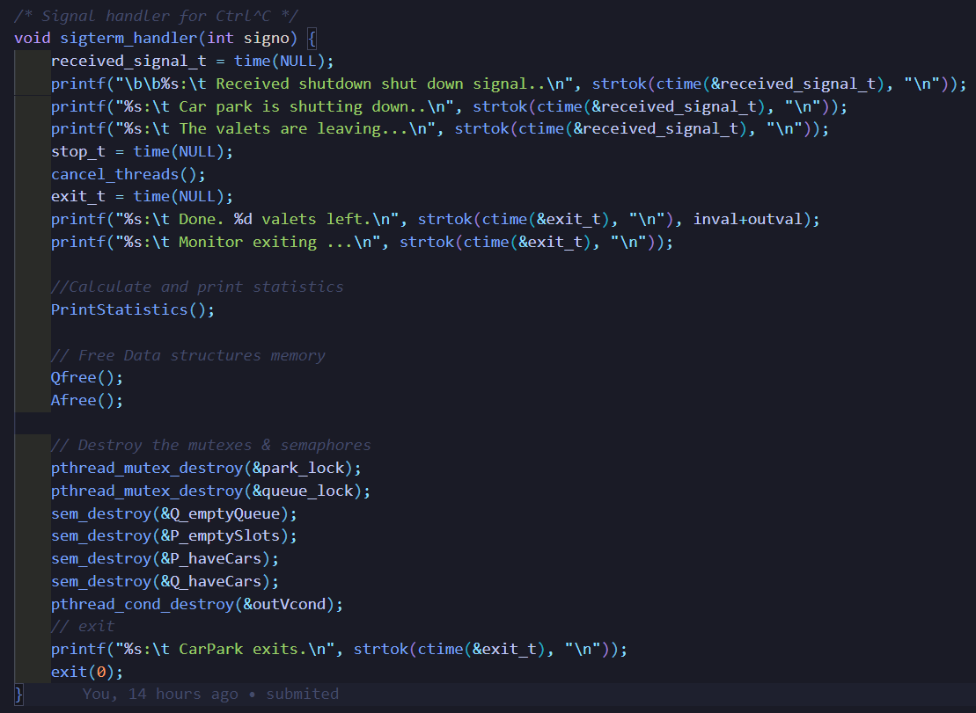

Slide 36
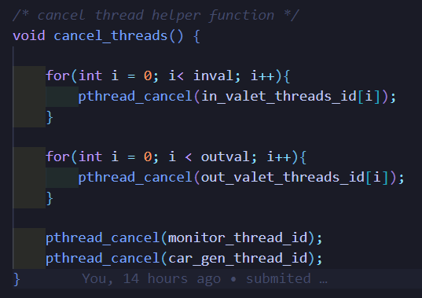

Slide 37
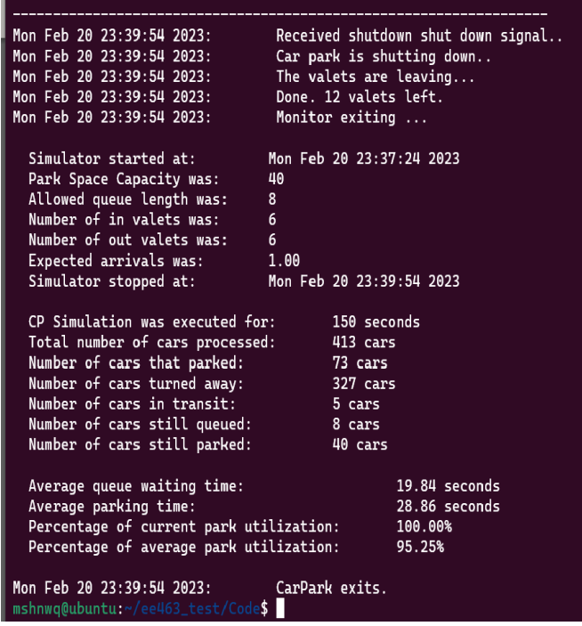

Slide 38

THANKS!
IF YOU HAVE ANY QUESTION, PLEASE DO NOT HESITATE

